Slide 1
ONLINE FOOD ORDERING SYSTEM
GROUP NO. 16
18BCA086 – SOURAV AGRAWAL
18BCA088 – SAHIL MANSURI
18BCA132 – DIVYANSH JAIN
Internal Guide : Ms. Manali Brahmbhatt
External Guide :Mr. Jugal Prajapati

Slide 2
INDEX
About Company
Company Details
Project Description
Requirement Gathering
Tools and Technologies Used
Existing System
Proposed System
Context Level/0 Level DFD
Level 1 DFD
Level 2 DFD
ERD
Data Dictionary

Slide 3
About Company
Aarnik Technology, as a website development company, holds a repu-ted image among its competition.
Company believes on developing completely unique and outstanding websites.
Aarnik Technology has always assured the best services to its clients as it has professionals working for its clients.
It excels in fields like website development, mobile app development, digital marketing, and ERP software development.

Slide 4

Company Details
Company Name : Aarnik Technology
Address : K8 Krishna Centre, Navrangpura, Ahmedabad 380009
Email Address : info@aarniktechnology.com
Contact Number : 9586248516

Slide 5
About Project
The Online Food Ordering System is a food ordering website. It
provides convenience to the customers by providing online ordering
system and overcomes disadvantages of the traditional
queuing systems.
It gives restaurants the ability to increase their sales and expand
their business.
With Online Food Ordering system, we can setup restaurant menu
online and customers can also track their orders with few simple
steps.

Slide 6
Requirement Gathering
What we have come up with is, an online food ordering system which is
completely web-based. This system can be a proven solution in today’s
modern world where people live a busy life.
In this system, admin can approve restaurant users to register on the website to accept orders, payment details and can also generate reports.
The restaurants can manage food items, accept orders, create menu categories, they can accept payments using the website
Today inflation rates are increasing rapidly, so in such time to have a
fine dining experience at the restaurant is not feasible for everyone.
This way people can have their favourite food delivered at their home.

Slide 7




Tools and Technologies Used
Frontend : Python Django v3.1
Backend : MySQL v5.6
Other Tools: Edraw Max 9.0,
Microsoft PowerPoint 2010

Slide 8
Existing System
In the old manual systems, there were series of drawbacks, as the whole system was maintained by humans. The processes consisting of keeping, maintaining and retrieving the data were very time consuming.
Records were never easily stored in sorted order and hence problems kept arising at the time of data retrieval.
Detecting errors in the data was also a big problem for restaurants with a large customer base and high frequency of orders.
Generation of reports was not easy for financial planning, as there would rise problems such as data redundancy and incomplete data.
In the light of current situations, it is more safe to have a food ordering website, rather than visiting the restaurant physically.

Slide 9
Proposed System
In some of the existing systems, Users must have a physical menu to order their food over a telephonic communication, this can often result
into misunderstanding due to unclear communication through
telephones.
What we propose is, a website-based Online food ordering system which can ease the problems of almost all users connected to it.
Using the Online Food Ordering System, users can order food through the website without standing in lines in front of the restaurant.
The users can manage their cart and can place orders from their carts, they can also track the delivery status of their orders, they can make payments using the website.
This system helps restaurants to manage all information regarding orders, their customers, payment related activities and feedbacks on a central server, the information can be retrieved as and when required.
To improve the user’s experience, the system also allows users to search based on names of dishes, and restaurants.

Slide 10
Context Level DFD / 0 Level DFD

Slide 11
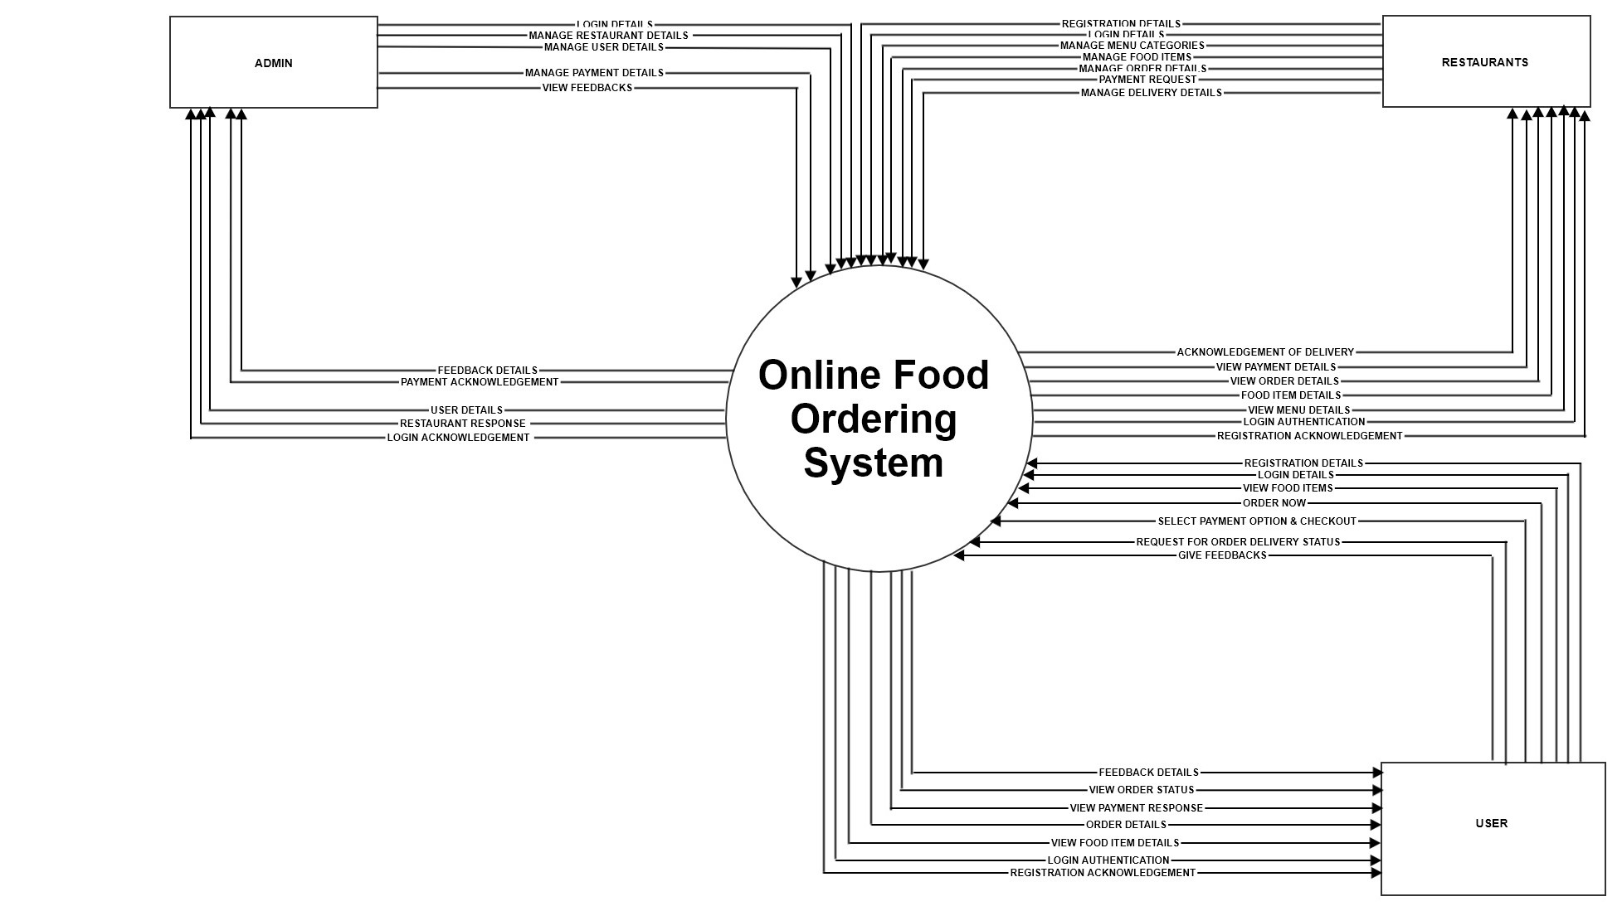

Slide 12
Level 1 DFD

Slide 13
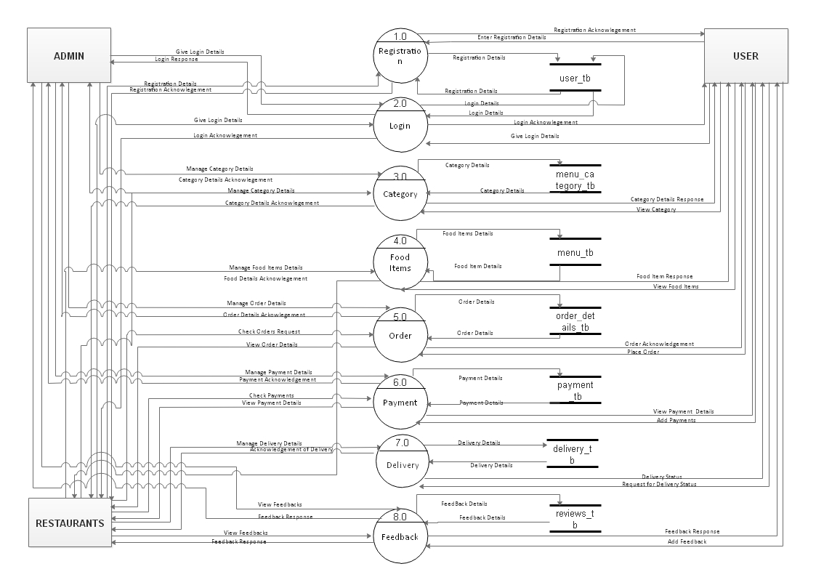

Slide 14
Level 2 DFD 2.0 Login

Slide 15
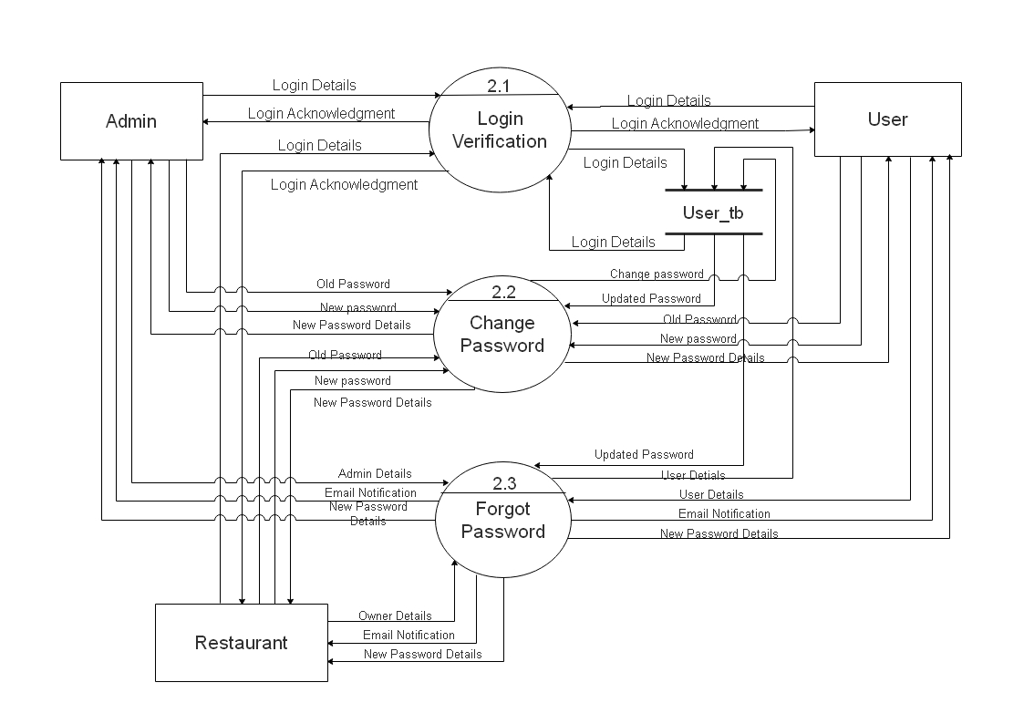

Slide 16
Level 2 DFD 3.0 Category

Slide 17
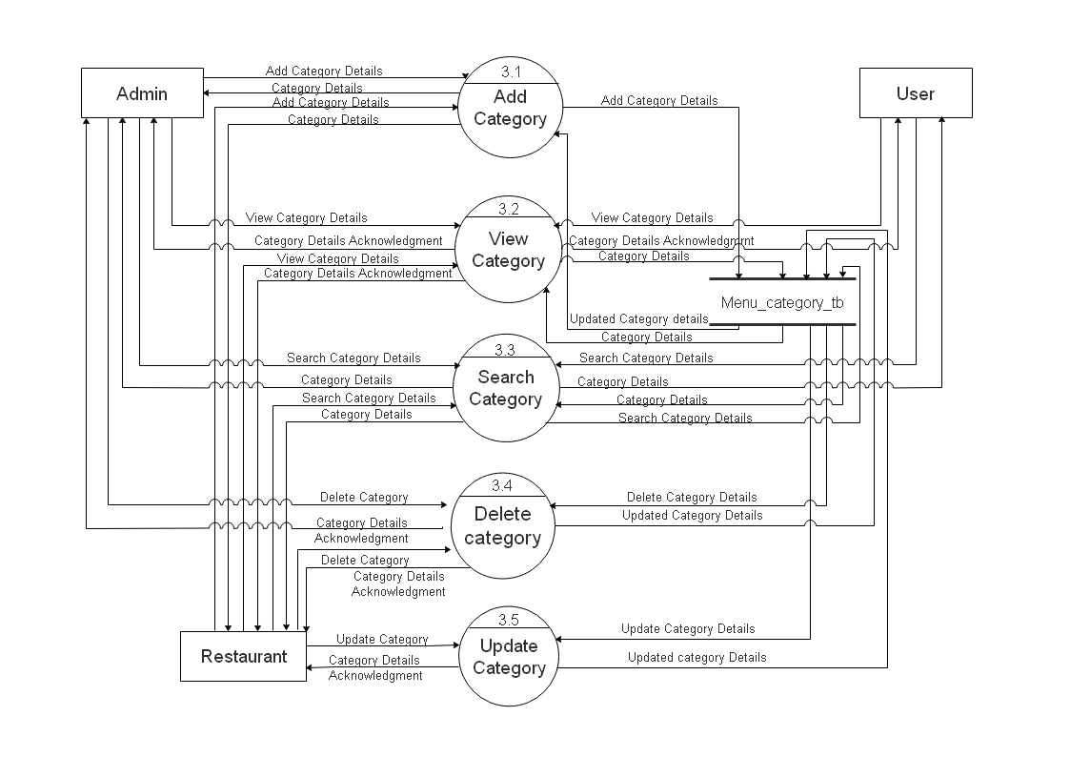

Slide 18
Level 2 DFD 4.0 Food Items

Slide 19
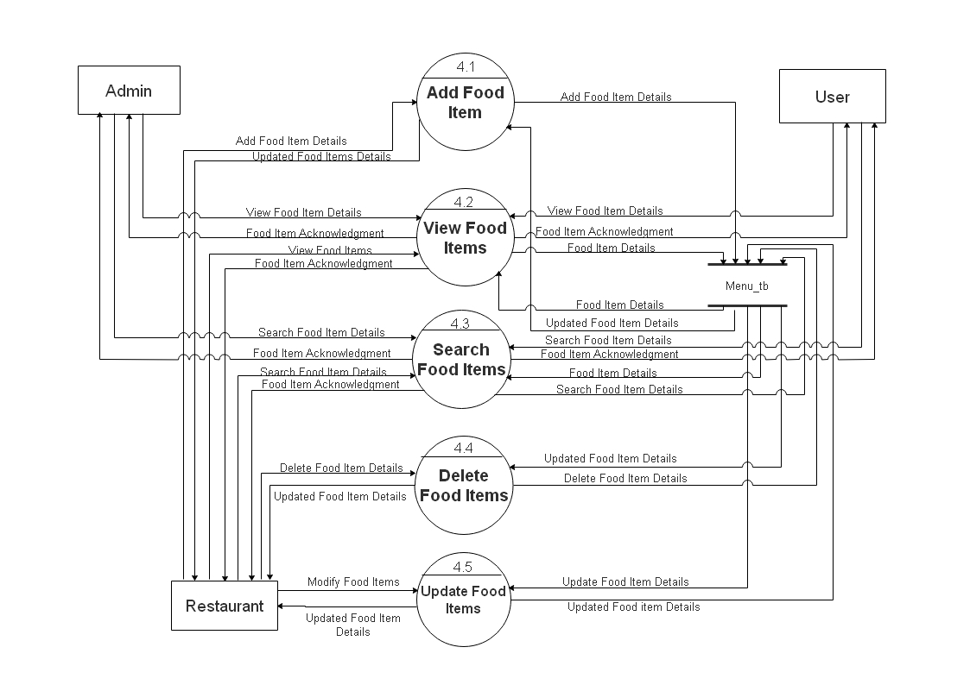

Slide 20
Level 2 DFD 5.0 Order

Slide 21
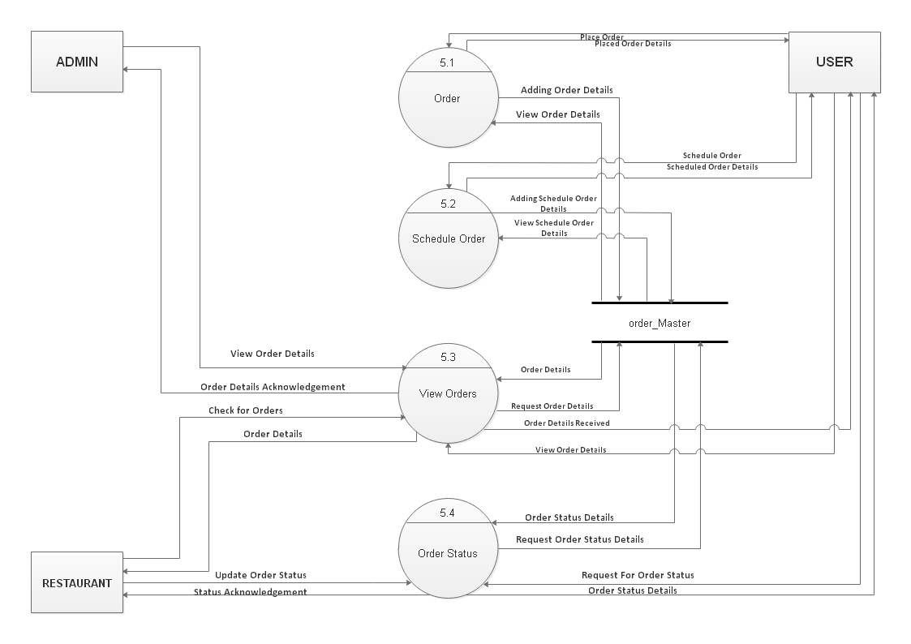

Slide 22
Level 2 DFD 6.0 Payment

Slide 23
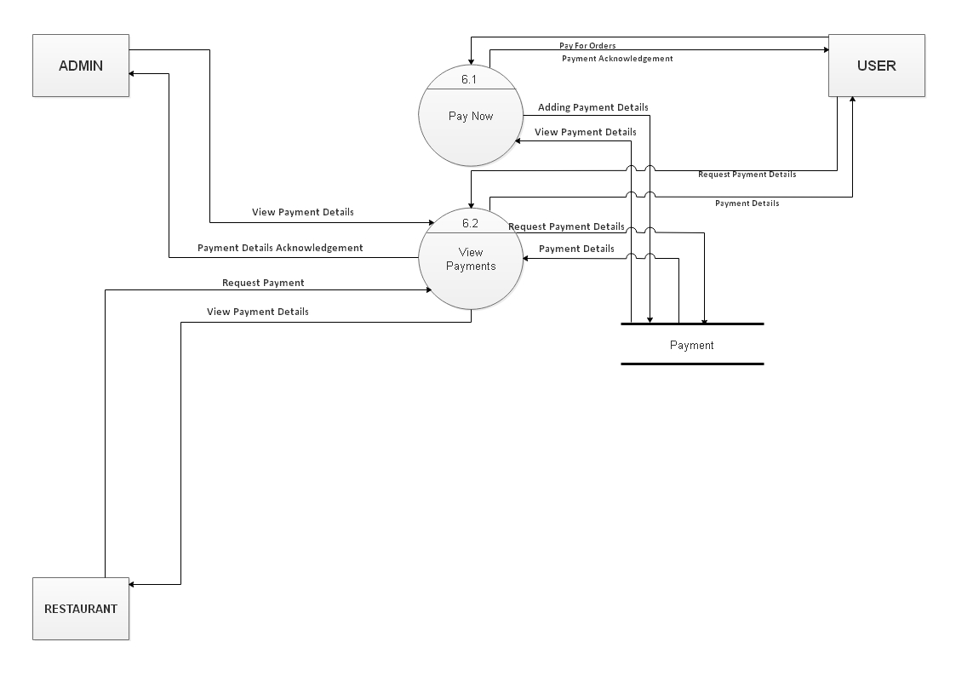

Slide 24
Level 2 DFD 7.0 Delivery

Slide 25
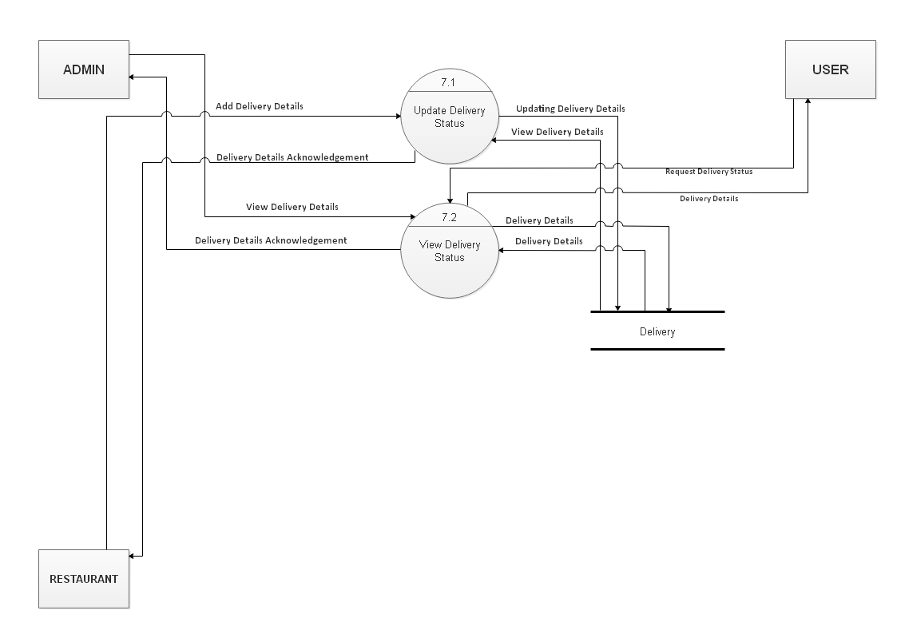

Slide 26
Level 2 DFD 8.0 Feedback

Slide 27
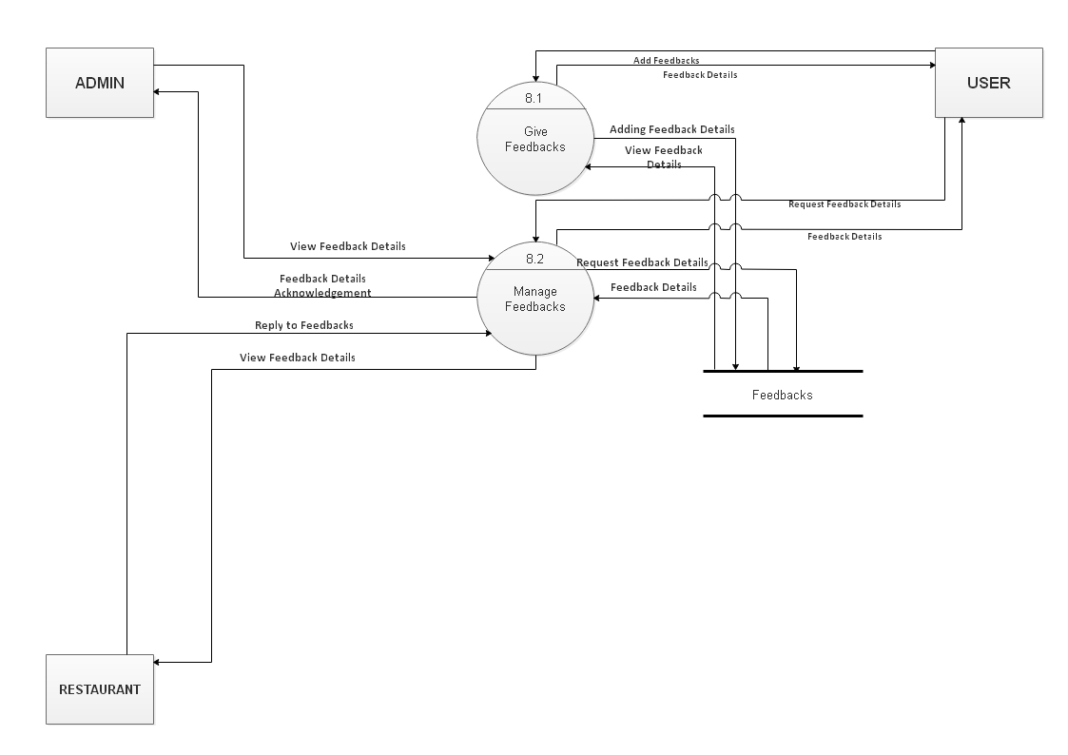

Slide 28
ER Diagram

Slide 29
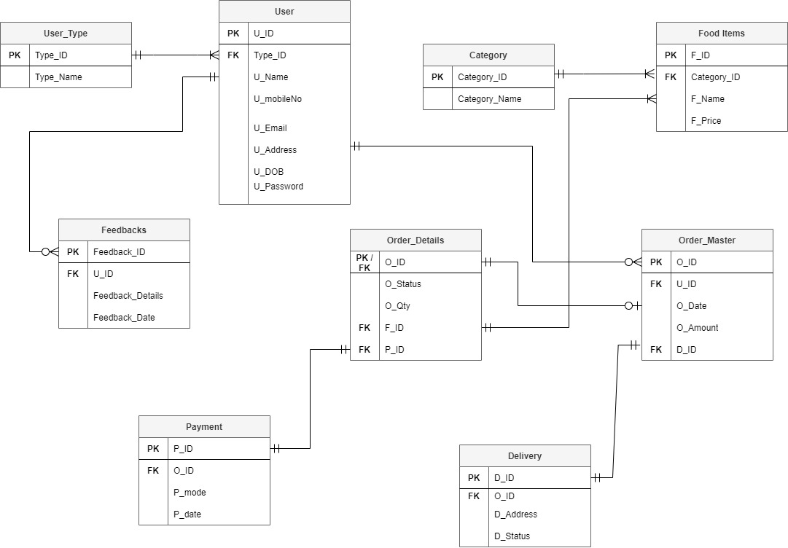

Slide 30
DATA DICTIONARY

Slide 31
Table Name : User
Description: This table stores all the details regarding users in the system
FIELD NAME | DATA TYPE | SIZE | CONSTRAINT | DESCRIPTION
U_ID | Integer | 10 | Primary Key | This field stores user ID.
Type_ID | Integer | 5 | Foreign Key | This field stores type id for a user.
U_Name | VarChar | 20 | Not Null | This field stores user’s name.
U_mobileNo | VarChar | 10 | Not Null | This field stores user’s mobile number.
U_Email | VarChar | 25 | Unique | This field stores user’s Email.
U_Address | VarChar | 150 | Not Null | This field stores user’s address.
U_DOB | Date | -- | Not Null | This field stores user’s date of birth.
U_Password | VarChar | 10 | Not Null | This field stores user’s password.

Slide 32
Table Name: user_type
Description: This table stores the user’s type.
FIELD NAME | DATA TYPE | SIZE | CONSTRAINT | DESCRIPTION
Type_ID | Integer | 5 | Primary Key | This stores A user’s Type Id.
Type_name | VarChar | 20 | Not Null | This field stores name for the type.

Slide 33
Table Name: category
Description: This table will store category details for the menu.
FIELD NAME | DATA TYPE | SIZE | CONSTRAINT | DESCRIPTION
Category_ID | Integer | 5 | Primary Key | This field will store food category ID.
Category_name | VarChar | 25 | Not Null | This field will store food category name.

Slide 34
Table Name: Food_Items
Description: This table will store details of Food Items
FIELD NAME | DATA TYPE | SIZE | CONSTRAINT | DESCRIPTION
F_ID | Integer | 10 | Primary Key | This field will store food item’s ID.
F_category_ID | Integer | 5 | Foreign Key | This field will store food item’s category ID
F_Name | VarChar | 25 | Not Null | This field will store food item’s name.
F_Price | Integer | 5 | Not Null | This field will store food item’s price.

Slide 35
Table Name: Order_Master
Description: This table will store necessary information of orders.
FIELD NAME | DATA TYPE | SIZE | CONSTRAINT | DESCRIPTION
O_ID | Integer | 10 | Primary Key | This field will store order ID.
U_ID | Integer | 10 | Foreign Key | This field will store user ID.
O_Date | Date | -- | Not Null | This field will store order date.
O_Amount | Integer | 5 | Not Null | This field will store order price.

Slide 36
Table Name: Order_Details
Description: This table will store all details of orders.
FIELD NAME | DATA TYPE | SIZE | CONSTRAINT | DESCRIPTION
O_detail_ID | Integer | 10 | Primary Key | This field will store order ID.
O_ID | Integer | 10 | Foreign Key | This field will store order ID.
O_Status | VarChar | 15 | Not Null | This field will store order status.
O_qty | Integer | 5 | Not Null | This field will store order quantity.
F_ID | Integer | 10 | Foreign Key, Not Null | This field will store food items in the order
O_pyt_ID | Integer | 5 | Foreign Key | This field will store payment ID for order.

Slide 37
Table Name: Payment
Description: This table will store information regarding Payment
FIELD NAME | DATA TYPE | SIZE | CONSTRAINT | DESCRIPTION
P_ID | Integer | 5 | Primary Key | This field stores payment ID.
O_ID | Integer | 10 | Foreign Key | This field stores order ID
P_mode | VarChar | 10 | Not Null | This field stores payment mode.
P_Date | Date | -- | Not Null | This field stores payment date.

Slide 38
Table Name: Delivery
Description: This table stores data for delivery details.
FIELD NAME | DATA TYPE | SIZE | CONSTRAINT | DESCRIPTION
D_ID | Integer | 10 | Primary Key | This field will store delivery ID.
O_ID | Integer | 10 | Foreign Key | This field will store order ID.
D_Address | VarChar | 150 | Not Null | This field will store delivery address for the order.
D_Status | VarChar | 15 | NotNull | This field will store delivery status.

Slide 39
Table Name: Feedbacks
Description: This table will include data about feedback details
FIELD NAME | DATA TYPE | SIZE | CONSTRAINT | DESCRIPTION
Feedback_ID | Integer | 5 | Primary Key | This field will store feedback ID.
U_ID | Integer | 10 | Foreign Key | This field will store user ID.
Feedback_Details | VarChar | 100 | Not Null | This field will store feedback details.
Feedback_Date | Date | -- | Not Null | This field will store date of feedback.

Slide 40
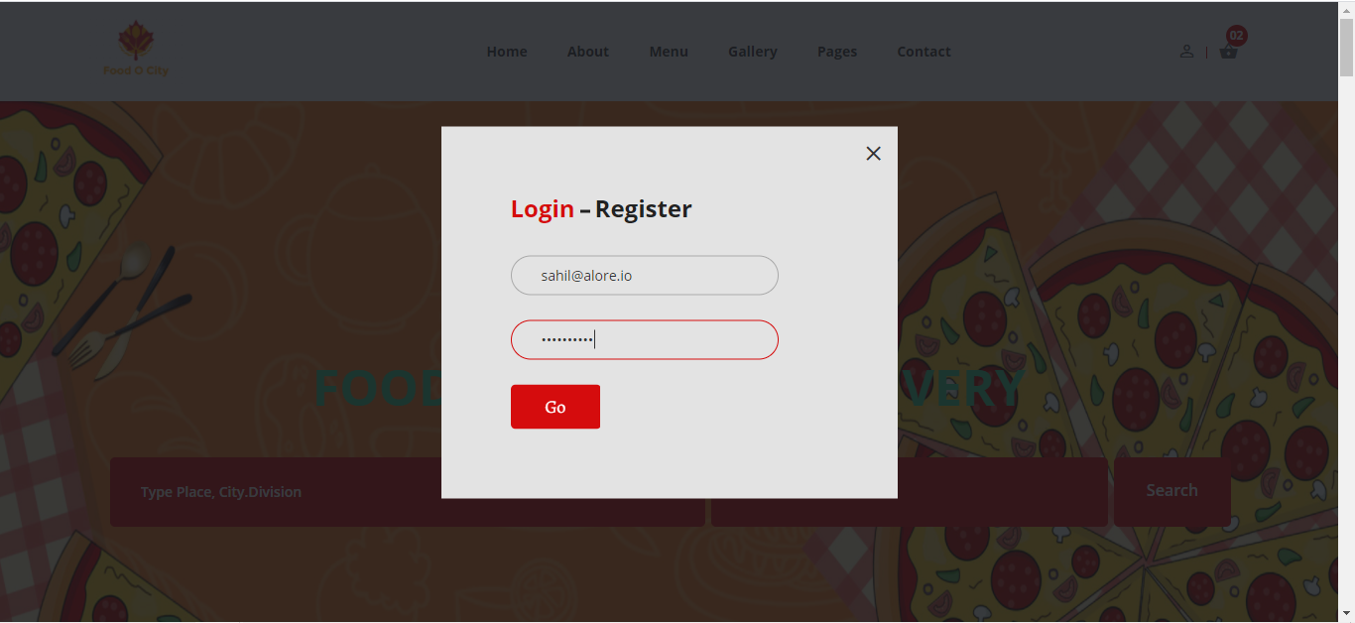
Login Page-Valid

Slide 41
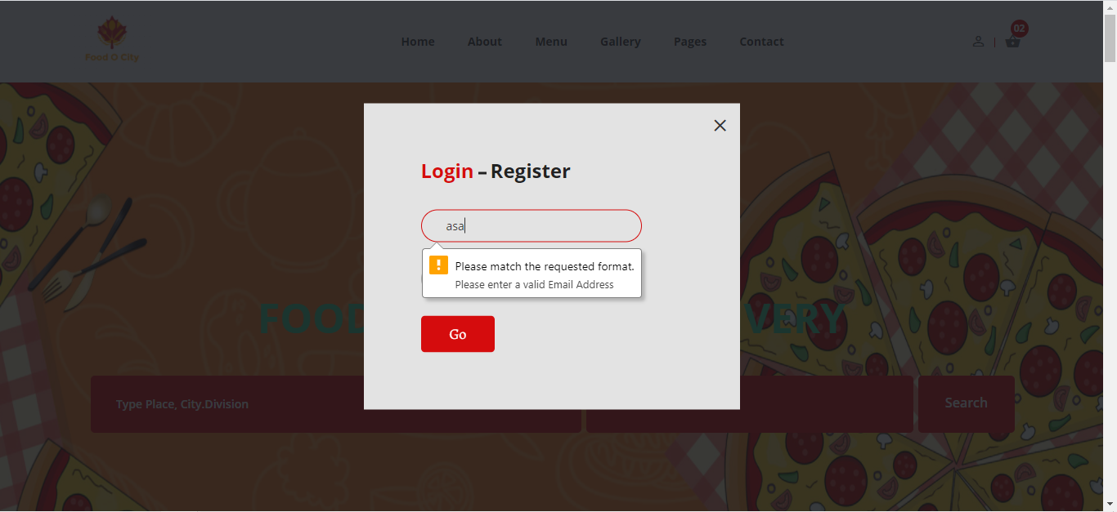
Login Page
Invalid Email

Slide 42
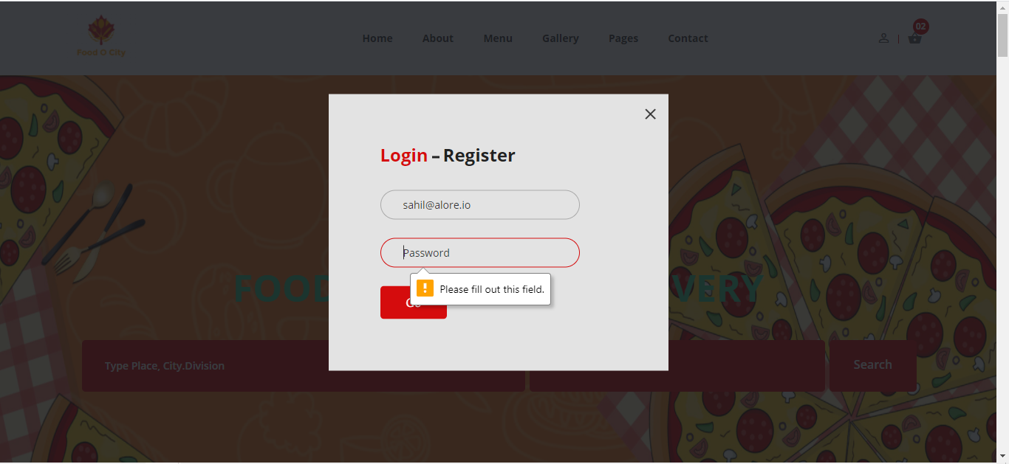
Login Page
Invalid Password

Slide 43
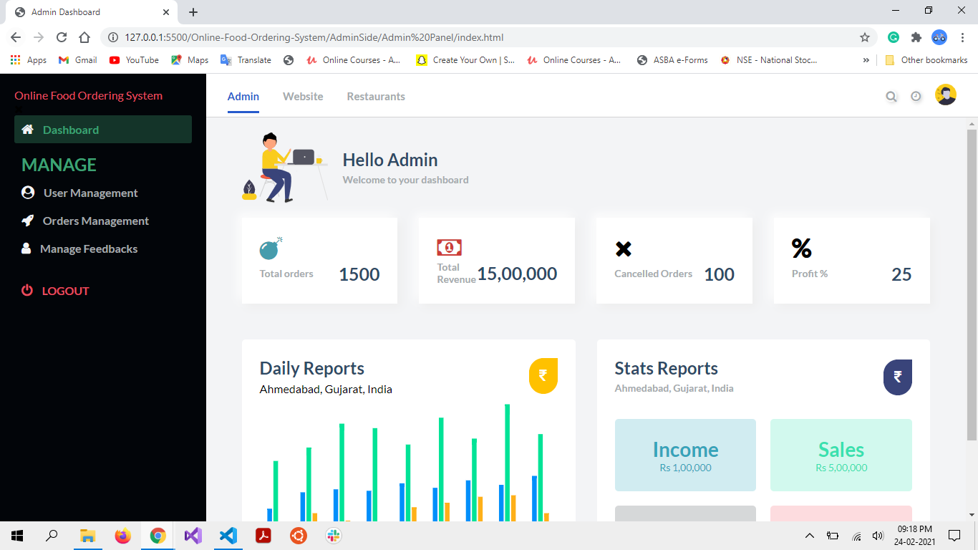
Admin Homepage

Slide 44
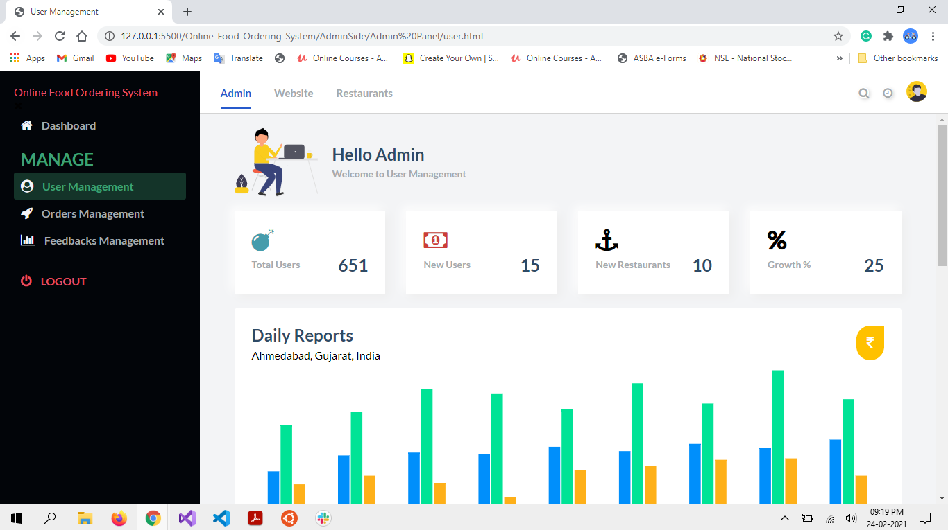
Admin User Management Page-1

Slide 45
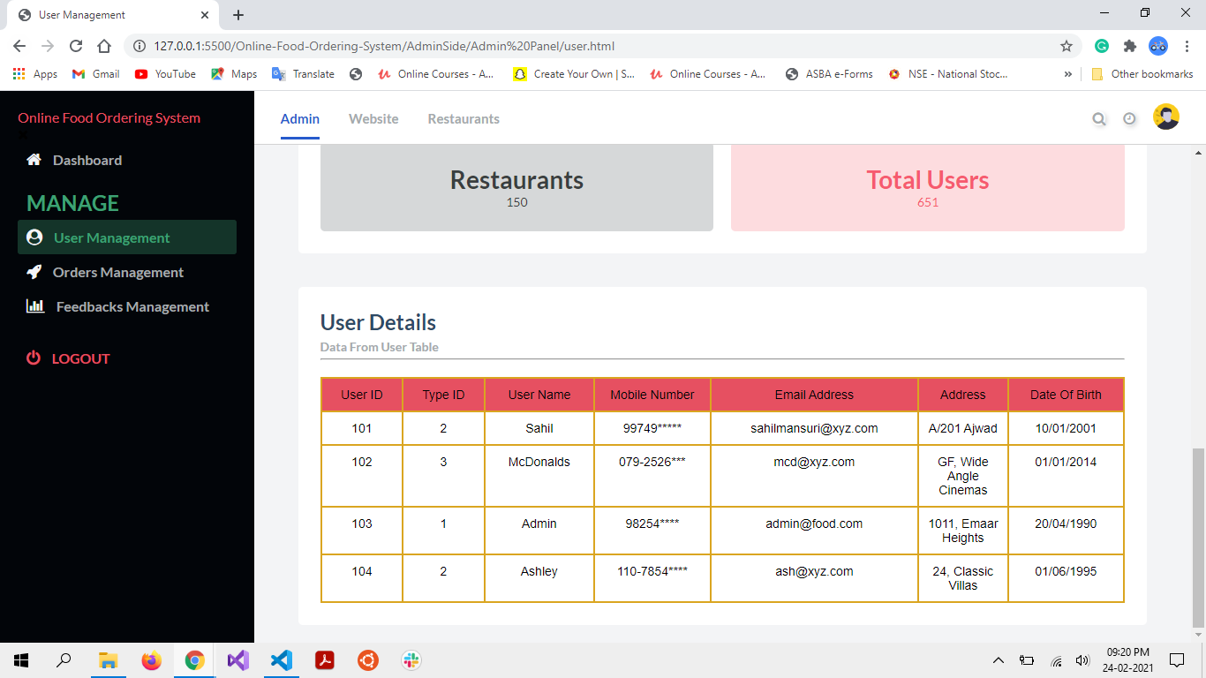
Admin User Management Page-2

Slide 46

Admin Order Management Page-1

Slide 47
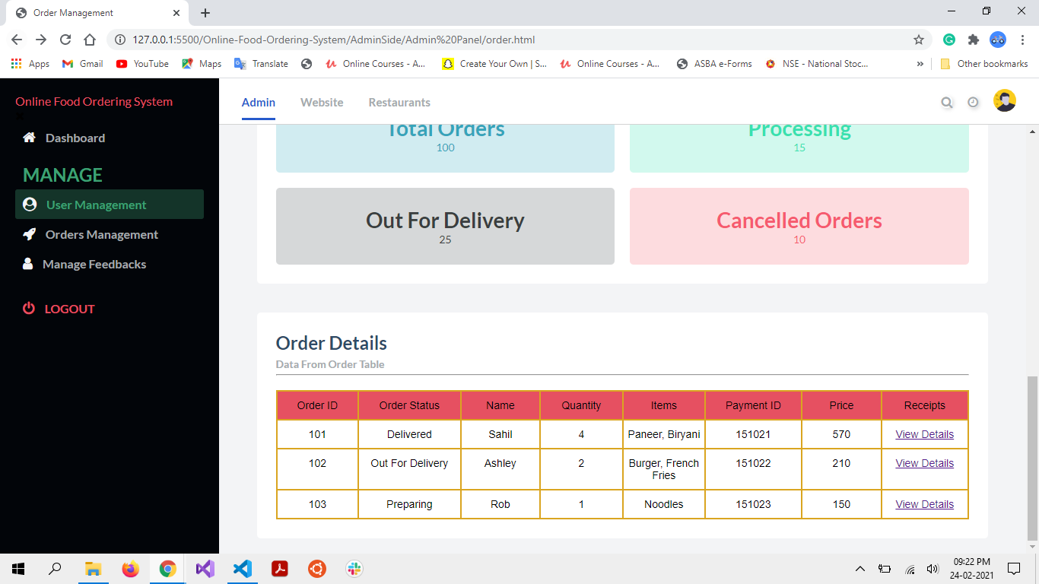
Admin Order Management Page-2

Slide 48
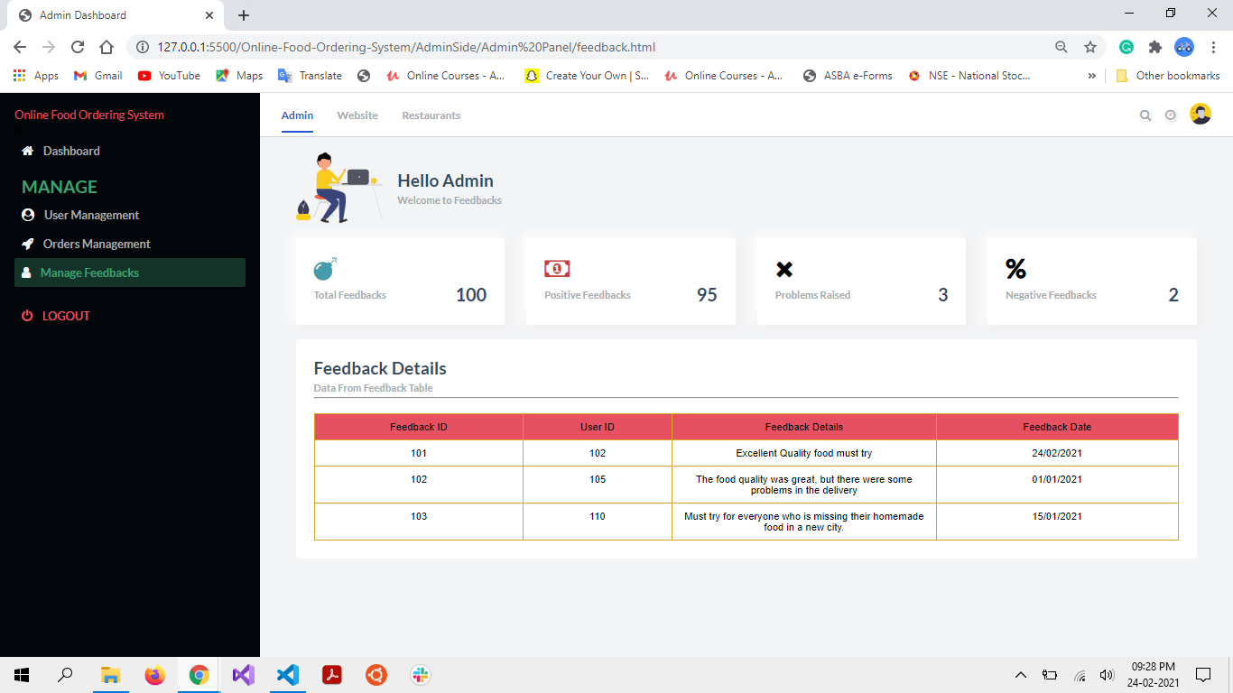
Admin Manage Feedbacks Page

